Slide 1
IMAGES,LINKS & LISTS

Slide 2
IMAGES
The HTML <img> tag is used to embed an image in a web page.
Images are not technically inserted into a web page; images are linked to web pages.
The <img> tag is empty, it contains attributes only, and does not have a closing tag.
The <img> tag has two required attributes:
src - Specifies the path to the image
alt - Specifies an alternate text for the image

Slide 3
Image Size - Width and Height
We can use the width and height attributes:
The width and height attributes always define the width and height of the image in pixels.
<img src=“./img_girl.jpg" alt="Girl in a jacket" width="500px" height="600px">

Slide 4
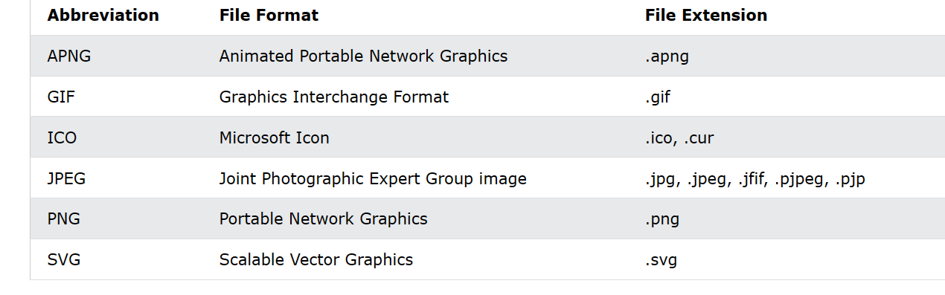
Common Image Format

Slide 5
LINKS
Links are found in nearly all web pages. Links allow users to click their way from page to page.
HTML links are hyperlinks.
The <a> tag defines a hyperlink
Syntax :
<a href="url">link text</a>

Slide 6
Links with Images
<a href="default.asp"> <img src=“sun.png" alt=“sunimage" style="width:42px;height:42px;"> </a>
An unvisited link is underlined and blue
A visited link is underlined and purple
An active link is underlined and red

Slide 7
LIST
HTML Lists are used to specify lists of information.
All lists may contain one or more list elements.
It allow web developers to group a set of related items in lists.
Each list item starts with the <li> tag.

Slide 8
TYPES OF LIST
There are three different types of HTML lists:
Ordered List or Numbered List (ol)
Unordered List or Bulleted List (ul)
Description List or Definition List (dl)

Slide 9
1. ORDERED LIST
In the ordered HTML lists, all the list items are marked with numbers by default.
It is known as numbered list also.
The ordered list starts with <ol> tag and the list items start with <li> tag.
List can be reversed also available <ol reversed>
Eg: <ol >
<li>Coffee</li>
<li>Tea</li>
<li>Milk</li>
</ol>

Slide 10
ORDERED LIST
There can be different types of numbered list:
Numeric Number (1, 2, 3)
Capital Roman Number (I II III)
Small Romal Number (i ii iii)
Capital Alphabet (A B C)
Small Alphabet (a b c)

Slide 11
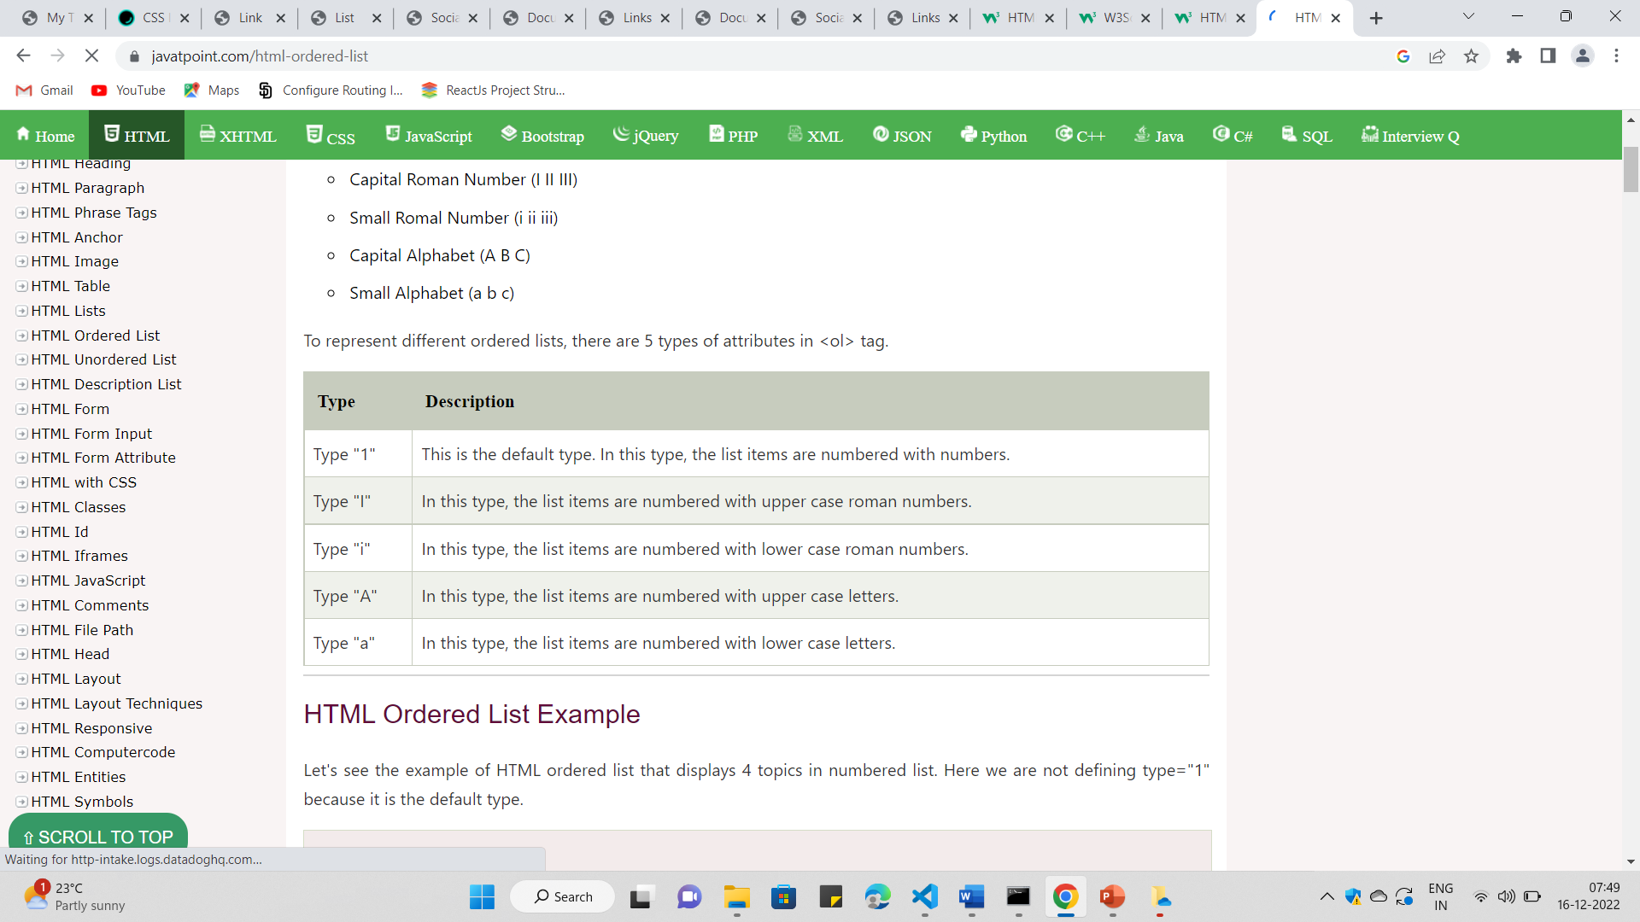
DIFFERENT TYPES OF ODERES

Slide 12
2.UNORDERD LIST
An unordered list starts with the <ul> tag.
The list items will be marked with bullets (small black circles) by default
Eg:
<h1>I love these drinks...!</h1>
<ul>
<li>Coffee</li>
<li>Tea</li>
<li>Milk</li>
</ul>

Slide 13
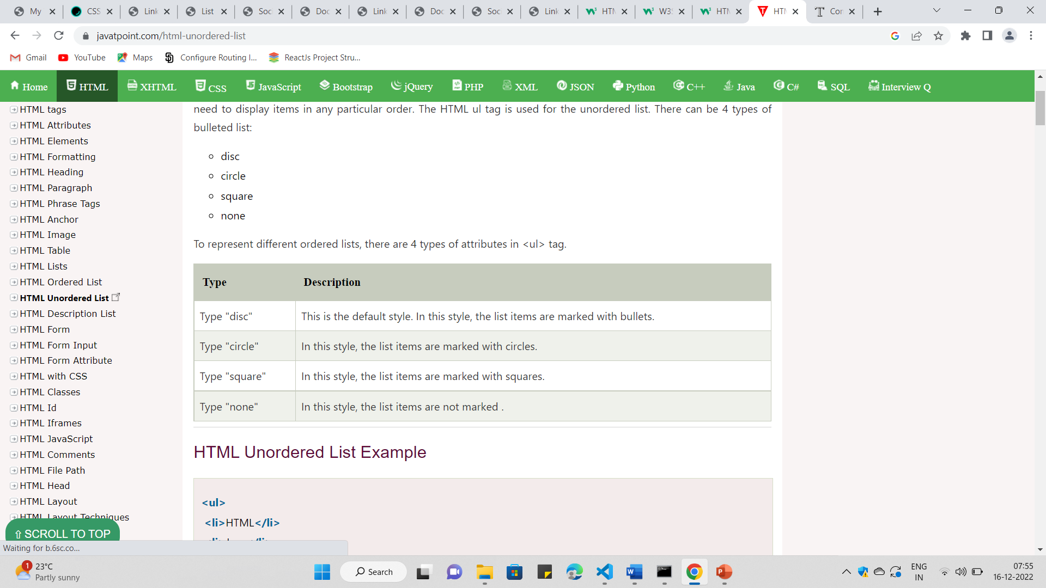
TYPES OF UNODERED LIST

Slide 14
3.DEFINITION LIST/DESCRIPTION LIST
A description list is a list of terms, with a description of each term.
The <dl> tag defines the description list
The <dt> tag defines the term (name)
The <dd> tag describes each term

Slide 15
<dl>
<dt>Coffee</dt>
<dd>- black hot drink</dd>
<dt>Milk</dt>
<dd>- white cold drink</dd>
</dl>

Slide 16
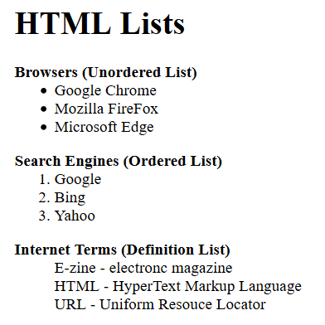
TASK 2

Slide 17
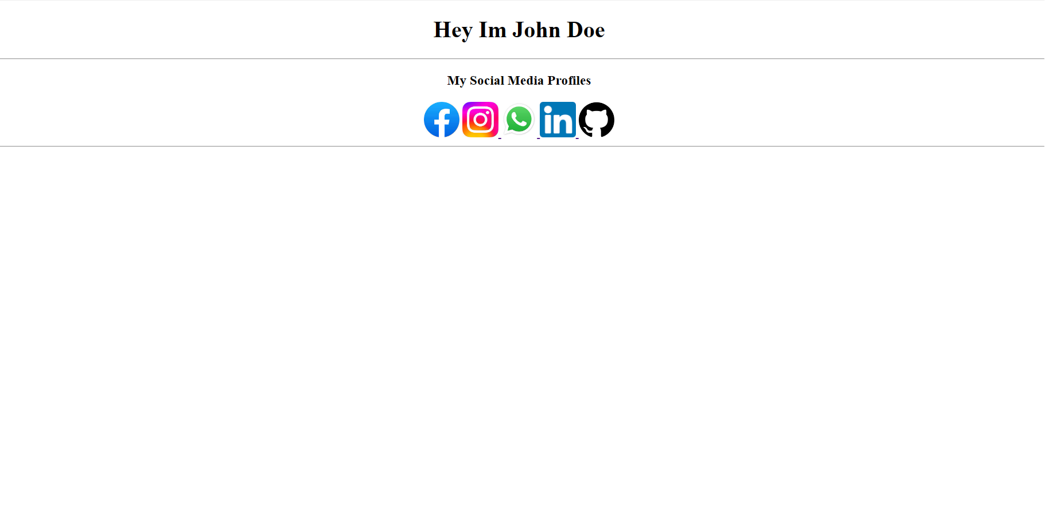
TASK 1

Slide 18
Thank You

